Slide 1
GPT-2: Language Models are Unsupervised Multitask Learners

Slide 2
Introduction
The capacity of the language model is essential to the success of zero-shot task
GPT-2: 1.5B parameters
Notes:
It can solve various tasks by simply conditioning the models on a few examples (few-shot) or instructions describing the task (zero-shot). The method of conditioning the language model is called “prompting”

Slide 3
Introduction
Aim: make a general AI for many tasks instead of narrow expert
P(output|input)->P(output|input, task)
Our speculation is that a language model with sufficient capacity will begin to learn to infer and perform the tasks demonstrated in natural language sequences in order to better predict them, regardless of their method of procurement
Notes:
It can solve various tasks by simply conditioning the models on a few examples (few-shot) or instructions describing the task (zero-shot). The method of conditioning the language model is called “prompting”

Slide 4
Training
Dataset: WebText, 40GB
Byte Pair Encoding
Fine-tuning没太看懂……
Notes:
It can solve various tasks by simply conditioning the models on a few examples (few-shot) or instructions describing the task (zero-shot). The method of conditioning the language model is called “prompting”

Slide 5
LLMs are Zero-Shot Reasoners

Slide 6
Introduction
LLM prompting: prompt can strongly guide the generation of answer
“pre-train and prompt”
(compared to classic “pre-train and fine-tune”)
Notes:
It can solve various tasks by simply conditioning the models on a few examples (few-shot) or instructions describing the task (zero-shot). The method of conditioning the language model is called “prompting”

Slide 7
Introduction
LLM prompting:
few-shot: conditioning the models on a few examples
zero-shot: instructions describing the task
CoT: Chain of Thought
feed LLMs with the step-by-step reasoning examples
Notes:
It can solve various tasks by simply conditioning the models on a few examples (few-shot) or instructions describing the task (zero-shot). The method of conditioning the language model is called “prompting”

Slide 8
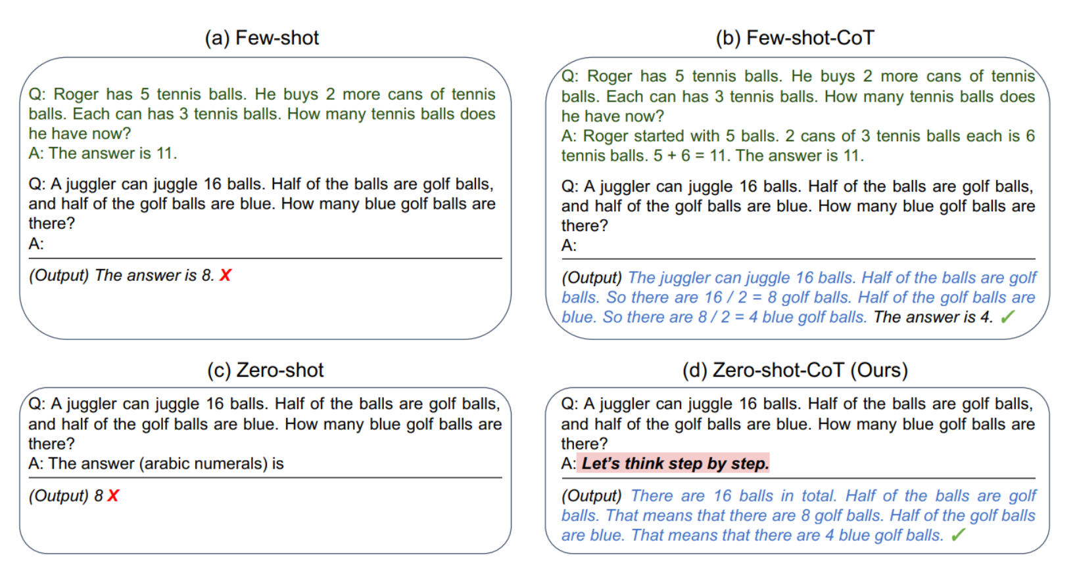
Introduction
Zero-shot-CoT description
Notes:
It can solve various tasks by simply conditioning the models on a few examples (few-shot) or instructions describing the task (zero-shot). The method of conditioning the language model is called “prompting”

Slide 9
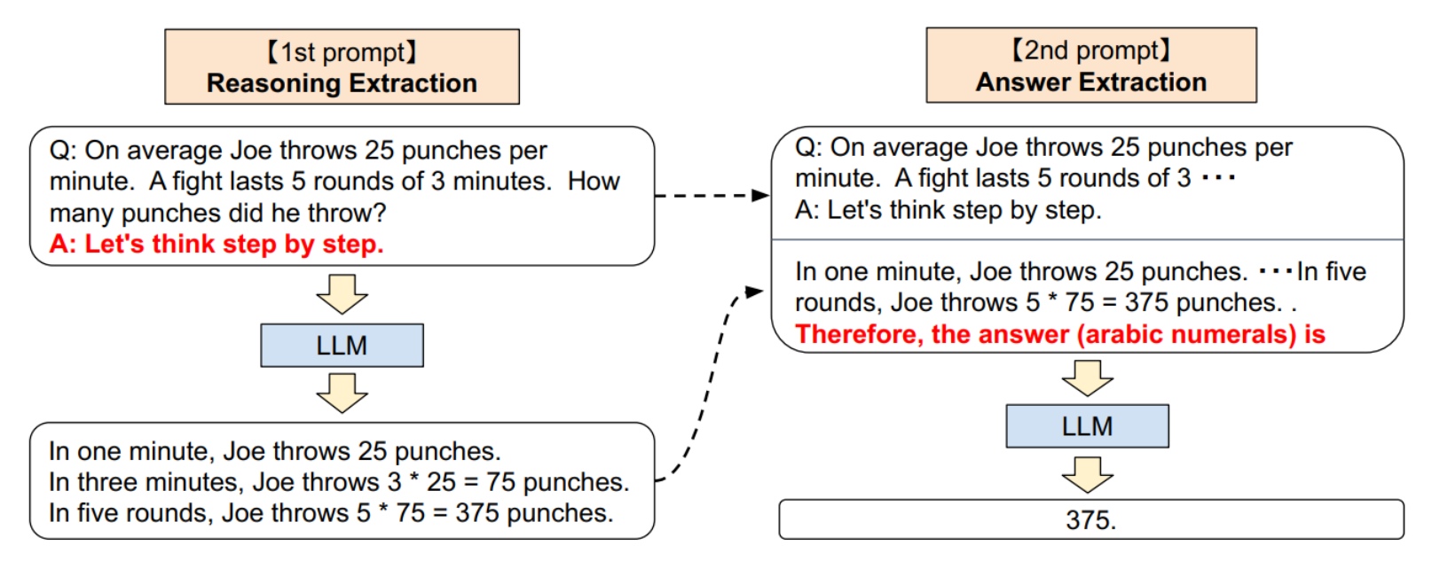
Implementation
Two Stage Prompting
Notes:
It can solve various tasks by simply conditioning the models on a few examples (few-shot) or instructions describing the task (zero-shot). The method of conditioning the language model is called “prompting”

Slide 10
Experiment
Dataset: 12 including arithmetic, commonsense, symbolic and others
Models: 17 models, 0.3B to 540B
Notes:
It can solve various tasks by simply conditioning the models on a few examples (few-shot) or instructions describing the task (zero-shot). The method of conditioning the language model is called “prompting”

Slide 11
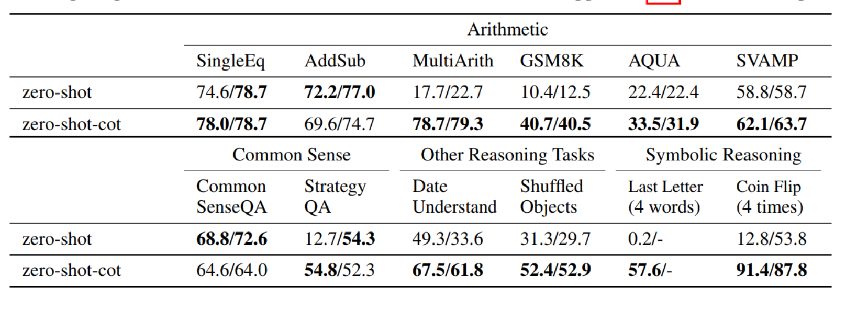
Results
For some datasets Cot performs better than classic zero-shot, some not
Notes:
It can solve various tasks by simply conditioning the models on a few examples (few-shot) or instructions describing the task (zero-shot). The method of conditioning the language model is called “prompting”

Slide 12
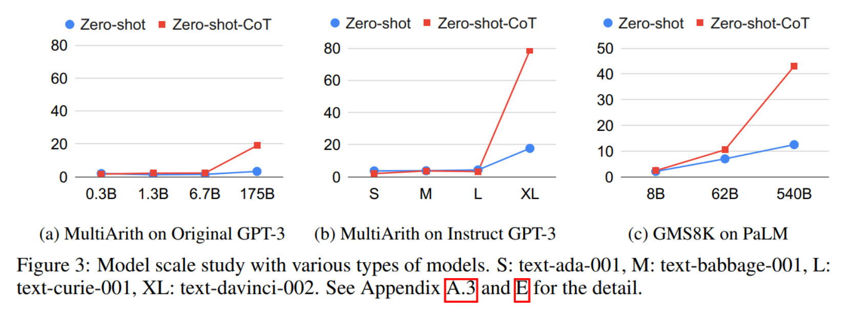
Results
Large-scale models demonstrate better reasoning
Notes:
It can solve various tasks by simply conditioning the models on a few examples (few-shot) or instructions describing the task (zero-shot). The method of conditioning the language model is called “prompting”

Slide 13
Results
Large-scale models demonstrate better reasoning
Notes:
It can solve various tasks by simply conditioning the models on a few examples (few-shot) or instructions describing the task (zero-shot). The method of conditioning the language model is called “prompting”

Slide 14
Results
Errors:
output multiple answer choices
unnecessary steps
Notes:
It can solve various tasks by simply conditioning the models on a few examples (few-shot) or instructions describing the task (zero-shot). The method of conditioning the language model is called “prompting”

Slide 15
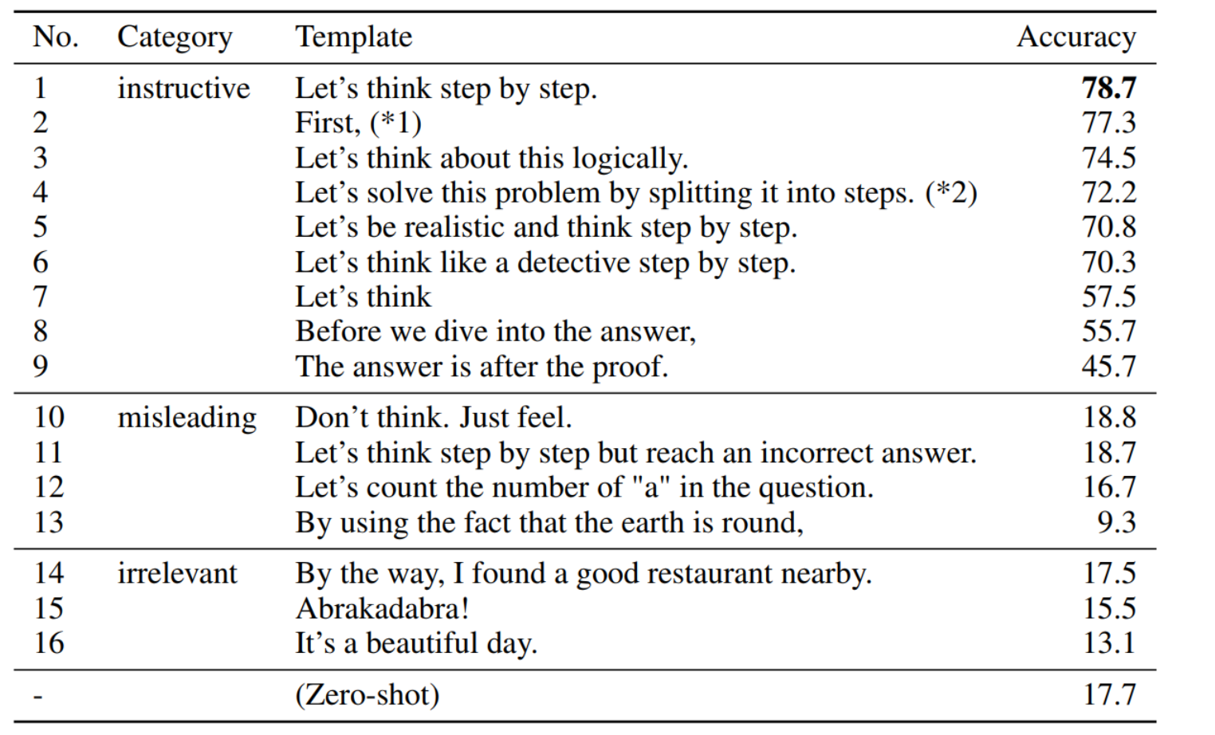
Results
Prompt affect Zero-shot-CoT:
Notes:
It can solve various tasks by simply conditioning the models on a few examples (few-shot) or instructions describing the task (zero-shot). The method of conditioning the language model is called “prompting”

Slide 16
LLMs as Optimizers

Slide 17
Introduction
LLM Optimizers:
Describe optimization problem in natural language
instruct LLM to iteratively generate new solutions
(compared to classic method: define optimization problem and derive update step)

Slide 18
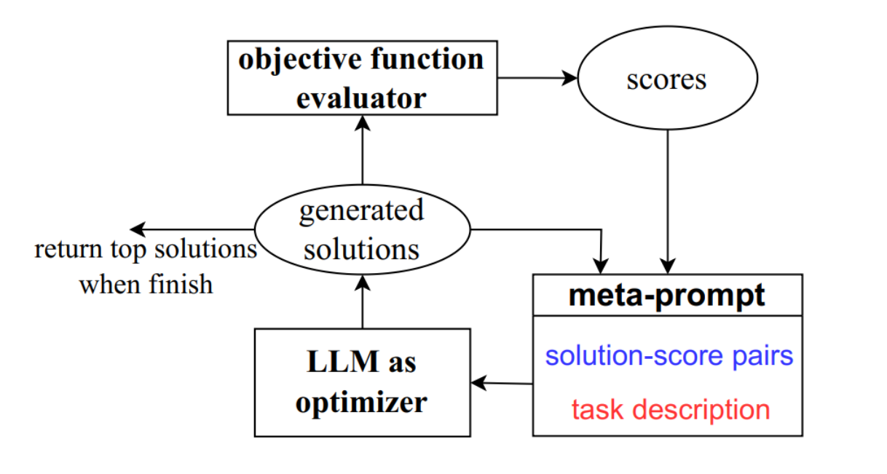
Implementation
OPRO Framework

Slide 19
Implementation
Meta-prompt design:
Optimization problem description
+
Previous prompts with accuracies

Slide 20
Implementation
Meta-prompt design:
Optimization problem description: meta-instructions
problem itself, objective function, solution constraints

Slide 21
Implementation
Meta-prompt design:
Previous prompts with accuracies:
ascending order
LLM can identify similarities between solutions with high scores, then generate potentially better ones

Slide 22
Implementation
Not all solutions achieve high scores and
monotonically improve over prior ones.
Solution: generate multiple solutions each step

Slide 23
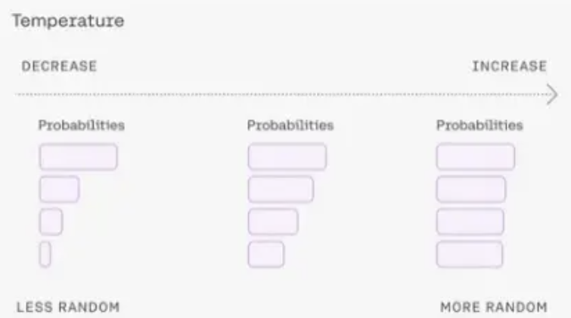
Implementation
Exploration-Exploitation trade-off problem
tune LLM sampling temperature (more or less random)

Slide 24
Mathmatical Optimization
Linear Regression:
start with 5 pairs, prompt new pair 8 times (each time one pair) each iteration. Remain best 20 pairs Result:
LLM can do black-box optimization (descent direction)
text-bison and gpt-4 converge faster
ground truth farther, more steps

Slide 25
Mathmatical Optimization
TSP:
also 5 init, 8 new each iter
compare to Gurobi Optimizer, Nearest Neighbor, Farthest Insertion
Results:
gpt-4 outperforms others
larger size, get worse quickly
Notes:
text-bison, gpt-4 converge faster than gpt-3.5-turbo

Slide 26
Mathmatical Optimization
Results:
LLMs are able to optimize different kinds of objective functions simply through prompting, and reach the global optimum for some small scale problems.
Limitations:
Large-scale optimization
optimization landscape of some objective functions are too bumpy for the LLM to propose a correct descending direction
Notes:
text-bison, gpt-4 converge faster than gpt-3.5-turbo

Slide 27
Prompt Optimization
TSP:
also 5 init, 8 new each iter
compare to Gurobi Optimizer, Nearest Neighbor, Farthest Insertion
Results:
gpt-4 outperforms others
larger size, get worse quickly
Notes:
text-bison, gpt-4 converge faster than gpt-3.5-turbo

Slide 28
LLMs are Human Level Prompt Engineers

Slide 29
Introduction
Natural language prompt engineering
Problem: plain language prompts do not always produce the desired results
Solution: algorithm using LLMs to generate and select prompt automatically
APE(Automatic Prompt Engineer)
Notes:
It can solve various tasks by simply conditioning the models on a few examples (few-shot) or instructions describing the task (zero-shot). The method of conditioning the language model is called “prompting”

Slide 30
Implementation
Approach:
gradient-based: expensive computing, no gradient access for some API
discrete prompt search
Notes:
It can solve various tasks by simply conditioning the models on a few examples (few-shot) or instructions describing the task (zero-shot). The method of conditioning the language model is called “prompting”

Slide 31
Introduction
At Contoso, we empower organizations to foster collaborative thinking to further drive workplace innovation. By closing the loop and leveraging agile frameworks, we help business grow organically and foster a consumer first mindset.

Slide 32
Primary goals
Annual revenue growth

Slide 33
Areas of growth
 | B2B | Supply chain | ROI | E-commerce
Q1 | 4.5 | 2.3 | 1.7 | 5.0
Q2 | 3.2 | 5.1 | 4.4 | 3.0
Q3 | 2.1 | 1.7 | 2.5 | 2.8
Q4 | 4.5 | 2.2 | 1.7 | 7.0

Slide 34
Business opportunities are like buses. There's always another one coming.
“
”
Richard Branson

Slide 35




Meet our team
Takuma Hayashi
Mirjam Nilsson
President
Chief Executive Officer
Flora Berggren
Rajesh Santoshi
Chief Operation Officer
VP Marketing

Slide 36








The full team
Takuma Hayashi
Mirjam Nilsson
Flora Berggren
Rajesh Santoshi
President
Chief Executive Officer
Chief Operations Manager
VP Marketing
Graham Barnes
Rowan Murphy
Elizabeth Moore
Robin Kline
VP Product
SEO Strategist
Product Designer
Content Developer

Slide 37
Plan for product launch
Deploy strategic networks with compelling e-business needs
Planning
Synergize scalable e-commerce
Marketing
Disseminate standardized metrics
Design
Coordinate
Foster holistically superior methodologies
Launch
Strategy
e-business applications
1
2
3
4
5

Slide 38
Timeline
Deploy strategic networks with compelling e-business needs
Sep 20XX
Synergize scalable e-commerce
Nov 20XX
Disseminate standardized metrics
Jan 20XX
Coordinate e-business applications
March 20XX
Foster holistically superior methodologies
May 20XX

Slide 39
Areas of focus
B2B market scenarios
Cloud-based opportunities
Develop winning strategies to keep ahead of the competition
Capitalize on low-hanging fruit to identify a ballpark value
Visualize customer directed convergence
Iterative approaches to corporate strategy
Establish a management framework from the inside

Slide 40
How we get there
ROI
Niche Markets
Supply chains
Envision multimedia-based expertise and cross-media growth strategies
Visualize quality intellectual capital
Engage worldwide methodologies with web-enabled technologies
Pursue scalable customer service through sustainable strategies
Engage top-line web services with cutting-edge deliverables
Cultivate one-to-one customer service with robust ideas
Maximize timely deliverables for real-time schemas

Slide 41
Summary
At Contoso, we believe in giving 110%. By using our next-generation data architecture, we help organizations virtually manage agile workflows. We thrive because of our market knowledge and great team behind our product. As our CEO says, "Efficiencies will come from proactively transforming how we do business."

Slide 42
Thank you
Mirjam Nilsson​
mirjam@contoso.com
www.contoso.com

